Slide 1
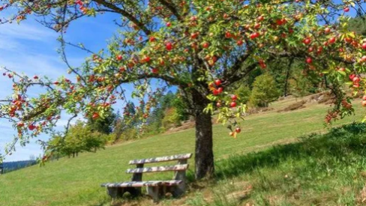





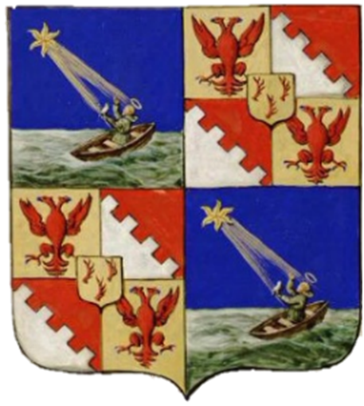
CUMBRAE’S WALKING ORCHARD

Slide 2
Project overview
A walking orchard for The Isle of Cumbrae
A project to plant 50-100 heritage Scottish fruit trees around the island’s perimeter 10-mile road.
Project aims:
Promote the island for its ecological and biodiverse assets – connect into the wider project with the draft name ‘Gem in the Clyde’.
Maximise the community’s natural asset to improve wellbeing
Increase walking/cycling visitors
Improve the island’s biodiversity by creating more food for wildlife
Connect with three other potential orchard planting projects
Provide inspiration for local people, with work experience and cross-generational connection

Slide 3
Cumbrae’s Walking Orchard
Location: Isle of Cumbrae perimeter road
Programme:
Spring 2026 – feasibility, planning, permissions
Summer 2026 – planting, initial media activity
Summer 2027 – secondary media activity

Slide 4
Partnerships
On Cumbrae
Cumbrae Community Council
Field Studies Council
The Cumbrae Forum
Carbon Neutral Islands Project
Cumbrae Community Development Company
Boys’ Brigade
The Cathedral of The Isles & College of The Holy Spirit
External partner
SCOTO will help secure funding and advise on engagement with tourists
Potential delivery partners
Scottish Fruit Trees (charity promoting heritage varieties)
Woodland Trust

Slide 5
Connected projects
This project would connect with a number of other tree and fruit tree planting projects currently in development on the island.
The Boys’ Brigade has successfully received funding from NAC to plant fruit trees in the Cathedral orchard.
There is a proposal to plant fruit trees on a field near the ferry slip.
There is a proposal to plant a community orchard in Ninian Park – this is subject to land ownership.
There is the potential to plant trees on NAC land – this needs to be investigated, potentially fruit trees could be planted at Farland Point
The project also connects into a proposal to stop campervans parking around the island, leaving waste and damaging the landscape. The plan is to change perceptions of the island, emphasising its biodiversity value. This project is called ‘Gem in the Clyde’ and is subject to a separate funding application.

Slide 6
Funding request
A fund of £775 has been secured to develop the project to delivery.
Carbon Neutral Islands will oversee the project, making a contribution of their time.
An island young person under 30 would act as project coordinator. (Identified through open recruitment.) They would be paid £15 an hour, and the project would expect to use 45 hours of their time. Total £675
They would be tasked to:
Engage
The tree provider to agree tree types and numbers, planting process etc, training for long term tree management
Landholders to obtain formal permissions
Stakeholder groups and organisations
Community members to find local volunteers
Seek funding
Through further grant funding
Exploring (in consultation with NAC) the idea of memorial trees for purchase as a way of financing and promoting the project
Develop a marketing plan for the project
An allowance of £100 has been budgeted to allow for the tree provider to visit the island and scope locations.

Slide 7
Outputs
1. Grant funding in place for tree purchase
2. Formal, written permissions
3. Finalised plan of
Tree types and species
Tree locations and numbers
4. Volunteer management plan in place, including long term maintenance plan
5. Connection with other planting projects
6. Marketing plan developed to cover all island planting plans

Slide 8
Outcomes
For the project coordinator: better understanding of project work, sense of pride and increased self esteem in having made positive change on the island, acting as model for peers and younger islanders, better connection with older community.
For the community: valuing the island’s land assets, empowerment so islanders feel they own their space – some don’t visit the other side of the island very often. This will enhance community wellbeing.
For project volunteers: new skills in tree planting, more understanding of fruit trees, positive connections from community working, enhanced wellbeing.
For visitors: clear connection between the island and its biodiverse riches. Sense of kindness from the island in providing walking food, which we hope will be reciprocated in visitor sentiment and behaviour. The orchard will encourage walkers and cyclists to engage is ‘slow tourism’, enhancing their wellbeing.
For the island’s biodiversity: new food sources, new nesting sites and shelter for small birds, food for bats and pollinators.

